Slide 1


FPHRA ANNUAL CONFERENCE
Title Goes Here
Legislative Update
Presented By:
William E. Grob
William.Grob@ogletreedeakins.com
(813) 221-7228

Slide 2
Overview
Department of Labor, Wage and Hour Division
Equal Employment Opportunity Commission
NLRB
OSHA
Supreme Court

Slide 3
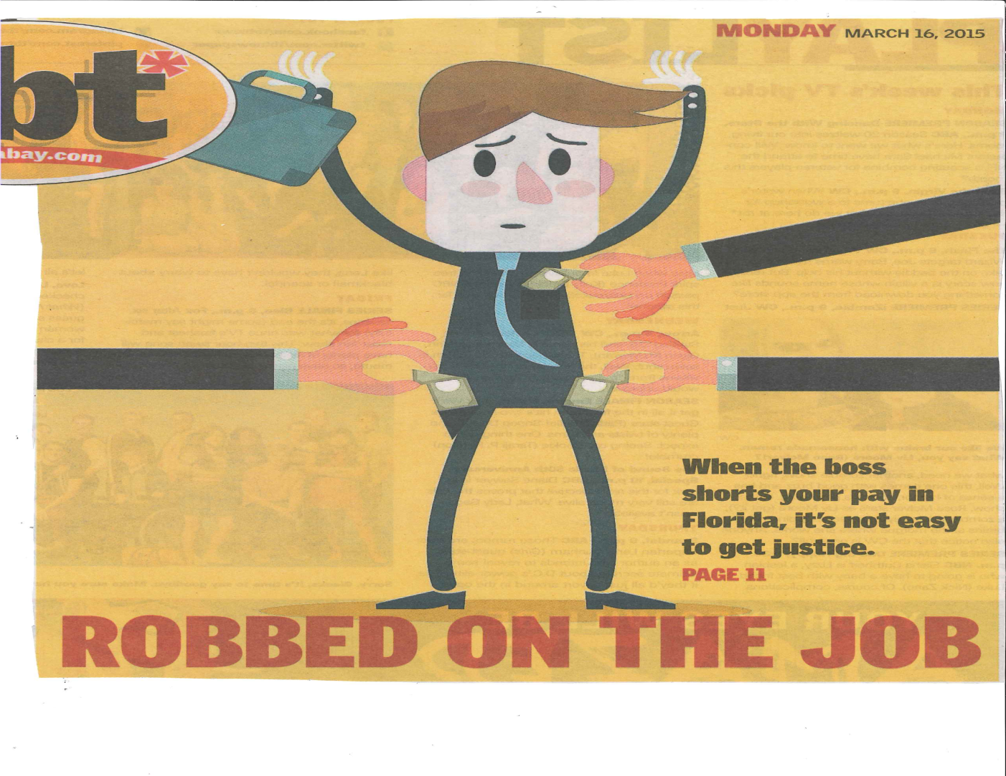
Local Wage Theft Ordinances

Slide 4
Hillsborough County
Study by Florida International University ranked Hillsborough County first in state wage theft.
Hillsborough County Commissioner Kevin Beckner is working toward a county ordinance covering all private employers that would set up a reporting, mediation and hearing process for wage theft victims.
The proposal will be modeled after the Miami-Date County Ordinance, which has recovered $5.8 million since its enactment in 2010.

Slide 5
Pinellas County
Council member Darden Rice, with the help of the Service Employees International Union, pushed for a city wage theft ordinance.
  Proposal passed.

Slide 6
Miami-Dade County
Covers all workers (more expansive than FLSA)
Process: a worker files a complaint (free of charge) and supplies any supporting documentation; the county then notifies the employer and attempts “conciliation”; if conciliation fails, the dispute goes before a hearing officer
An employer found guilty must pay back wages plus “liquidated damages” equal to 2x the back wages owed
The ordinance lacks an enforcement mechanism, so the employee must file suit if the employer refuses to pay

Slide 7

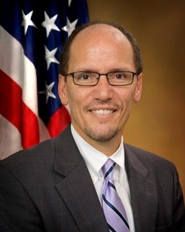
Department of Labor (“DOL”)
Secretary Thomas Perez

Slide 8
Tips Targeted as States’ Minimum Wages Rise
Labor groups are setting their sights on how tipped workers in the food industry are paid – advocating for swapping the tipped minimum wage in favor of a so-called living wage for all restaurant workers.
According to the National Restaurant Association, the vast majority of restaurants follow the rules for applying the tip credit.
Connecticut, Seattle, and San Diego have introduced or passed legislation to raise minimum wage to over $10.00 per hour, well in excess of the federal rate of $7.25.

Slide 9
Proposed Changes to White Collar Exemptions
March 2014 Memorandum signed by President Obama -- “Updating and Modernizing Overtime.”
Involves exemptions for Executive, Administrative, Professional, Outside Sales and Computer Employees.
White collar exemptions “have not kept up with our modern economy.”
Approximately 3.1 million people would be entitled to overtime if the $455 per week threshold had kept up with inflation (estimated at $1,000 per week).
Notes:
Accordingly, the administration is expected to order changes that would increase the minimum salary for the salary basis test and make it more difficult to meet the primary duties tests to qualify for the exemptions.
Issuing the new regulations to implement these changes is part of the DOL’s Spring Agenda. This probably can be construed as meaning that the WHD will wait until after the November 2014, elections to publish a proposed rule for notice and comment. At a minimum, it can be said that the DOL is heeding the president’s March 2014 memorandum. The proposed rule is intended to streamline the “white-collar” overtime exemption by increasing the salary level and revising specific job duties required to qualify for exemption. Of course, the notice of proposed rulemaking (NPRM) is merely the start of the rulemaking process, which will also include a period of public comment, agency review, and OMB review prior to final action.

Slide 10
DOL Proposal to Revise Part 541 Overtime Regulations
Proposal to Increase Salary Level Tests
  Standard salary benchmark is 40th percentile for earning for full-time salaried workers
    $921 a week or $47,892 annually using 2013 data
    Projected to be $970 a week or $50,440 by first quarter 2016
  Salary level test for highly compensated employee is 90th percentile of earnings for full time salaried employees
    $122,148 in annual compensation based in 2013 data

Slide 11
DOL Proposal to Revise Part 541 Overtime Regulations
Other Salary Proposals
  Whether to allow a portion of a non-discretionary bonus to count in satisfying the salary level test
    DOL is considering 10% by solicits comments on percentage
    DOL not inclined to include commission or fringe benefit payments to satisfy the standard salary level test
  Whether to limit the time period during which such non-discretionary compensation must be paid in order to count it against the salary level test
    DOL is considering such payments be made monthly or more frequently to maintain integrity of salary tests

Slide 12
DOL Proposal to Revise Part 541 Overtime Regulations
Other Salary Proposals
  Mechanisms to automatically increase the salary level, either:
    Maintain salary level of 40th percentile of weekly wages of all full-time salaried employees, or
    Adjust salary level test for changes in Consumer Price Index for all urban consumers (CPI-U)

Slide 13
DOL Proposal to Revise Part 541 Overtime Regulations
Standard Duties Tests: Primary Duty
  DOL concerned that some exempt employees spend disproportionate amount of time performing non-exempt work
  Duties tests work in tandem with salary tests
  DOL seeking to determine whether change in the duties test are warranted

Slide 14
DOL Proposal to Revise Part 541 Overtime Regulations
Comments Invited on 5 Questions on Effectiveness of Current Duties Tests:
  What changes to the duties tests should be made, if any;
  Should DOL establish a minimum amount of time employee spends performing primary duties of exempt work, if any;
  Is there a better indicator of time spent performing primary duty, such as California’s primarily engaged in standard or a threshold below 50%;
  How effective is single standard duties test for each exemption versus reconsidering long/short duties test structure; and
  Does the concurrent duties regulation for exempt executive employees work or should there be a limitation on the time spent performing non-exempt work?

Slide 15
Wage-Hour Testimony Before Congress
FLSA Lawsuits
YEAR 2000
1,935 Nationwide
YEAR 2014
8,066 Nationwide

Slide 16
Challenges to Exemptions for Home Care Workers
December 22, 2014 ruling in Home Care Association of America v. Weil (No. 14-cv-967) vacated the DOL’s new regulation and means that the amendment will not take effect on January 1, 2015, unless it is stayed or otherwise reversed by an appellate court.
The DOL has not stated how it intends to respond, though an appeal is expected.
The court’s ruling does not affect the other parts of the new regulation, including its narrowed definition of what constitutes “companionship services” and its recordkeeping requirements.
Notes:
16

Slide 17
DOL Enforcement in Florida
The DOL and the Florida Department of Revenue signed a memorandum of understanding January 13, 2015, agreeing to share information and coordinate law enforcement to reduce the misclassification of employees as independent contractors.
Notes:
17

Slide 18


Slide 19
FY 2014 Performance Report
On November 18, 2014, the EEOC issued its Performance Report for FY 2014 (individual charge statistics should be published within the next few months).
88,778 private sector charges, a decrease of about 5,000 charges from FY 2013
  $296.1 million in monetary relief obtained through mediation, conciliation and other administrative enforcement ($144.6 million in through mediations).
  $22.5 million in monetary relief obtained for charging parties through litigation, and $74 million in monetary relief for federal employees and applicants.

Slide 20
FLORIDA STATISTICS
 | FY 2010 | FY 2011 | FY 2012 | FY 2013
TOTAL CHARGES | 7,779 | 8,088 | 7,940 | 7,597
Race | 2,402 | 2,598 | 2,274 | 2,533
Sex | 2,359 | 2,406 | 2,698 | 2,186
National Origin | 1,379 | 1,446 | 1,352 | 1,649
Religion | 280 | 313 | 316 | 298
Color | 224 | 266 | 162 | 569
Retaliation (All) | 2,942 | 3,231 | 3,036 | 3,095
Retaliation (Title VII) | 2,607 | 2,864 | 2,590 | 2,564
Age | 1,729 | 1,782 | 1,694 | 1,641
Disability | 1,681 | 1,732 | 1,789 | 1,825
Equal Pay Act | 25 | 36 | 50 | 46
GINA* | 7 | 12 | 12 | 9

Slide 21
Newly Issued Guidance On Pregnancy Discrimination (July 2014)
First guidance in over 20 years
PDA prohibits discrimination based on:
  Current Pregnancy
  Past Pregnancy
  Potential or Intended Pregnancy
  Medical Conditions Related to Pregnancy or Childbirth
Available at: www.eeoc.gov/laws/
guidance/pregnancy_guidance.cfm

Slide 22
Enforcement Guidance on Pregnancy Discrimination and Related Issues
EEOC is importing a reasonable accommodation obligation into the PDA, using a disparate treatment analysis.
The Guidance seems to be saying that a pregnant employee gets “reasonable accommodation” under the PDA regardless of whether the condition is even a disability under the ADA.
Anything outside of a normal pregnancy is likely to be a disability.

Slide 23
EEOC Strategic Enforcement Plan
Fiscal Years 2013-2016
Priorities:
  Eliminating systemic barriers in recruitment and hiring;
  Emerging issues: ADA Amendments Act; Lesbian, Gay, Bisexual, and Transgender issues; pregnancy and forced unpaid leave;
  Compensation & gender;
  Access to the legal system – retaliation & releases;
  Harassment.

Slide 24
EEOC Strategic Enforcement Plan
Criminal Background Checks
  Focus on disparate impact.
  Race & National Origin.
  Blanket prohibitions on hiring convicted felons may generate EEOC interest.
  EEOC has pursued employers that have broad prohibitions on hiring applicants with conviction records.
  At least one court has disagreed with the EEOC.

Slide 25
1984 Has Come and Gone, but Big Brother Is Here to Stay
Administrative agencies are making the cost of doing business rise for employers.
Increased regulation = increased expenses for employers.
  Employers must frequently review policies and procedures to maintain compliance;
  Employers must train supervisors to avoid liability;
  Employers face government fines and private lawsuits if they get it wrong.
The NLRB and OSHA are becoming more aggressive.

Slide 26


Slide 27
Even If You Don’t Have A Union
Purple Communications Inc.
In the past, employees had no right to use their employers’ e-mail for “Section 7 purposes.”
On December 11, 2014, the Board reversed its prior position and held that employee use of e-mail for activities directed to terms and conditions of employment must presumptively be permitted by employers who have given employees access to their e-mail systems.

Slide 28
Even If You Don’t Have A Union
Purple Communications Inc.
The decision means that employees have the legal right to use company e-mail for non-business related reasons, including union organizing.
The majority opinion found e-mail to be akin to the "new water cooler," a "natural gathering place" for employees.
The shift in the Board’s opinion reflects the change it in its political makeup, with its three Democrats reversing prior precedent and its two Republicans dissenting.

Slide 29
Ambush Election Rules
On December 12, 2014, the NLRB implemented the long-anticipated “ambush election” rules, which govern the procedures for union representation elections.
The new rules are in effect.
These rules arguably constitute the most sweeping regulatory change ever implemented by the Board, altering union representation election procedures that have been in place for decades.
Notes:
The NLRB has said the proposed changes are intended to modernize processes, enhance transparency and reduce needless litigation and delay. One of the biggest gripes about the rules is they shorten the time period between the filing of an election petition and the election itself, cutting into employers' ability to make their case to workers about the benefits and pitfalls of unionization.

Slide 30
Ambush Election Rules
Simply stated, the rules tilt the playing field dramatically in favor of unions by creating an environment in which many union elections will occur in just 10 to 21 days after the union requests a vote.
In addition, the rules essentially eliminate most employer rights during the representation case process.
The new rules now make it easier for unions to successfully organize all employers, in all industries.
Union election win rates are expected to increase significantly.

Slide 31
Facebook 'Like' Protected By Labor Law, NLRB Says
The National Labor Relations Board ruled on August 25, 2014 that clicking Facebook's “like” button was protected, concerted activity.
The Board found that Triple Play Sports Bar and Grille unlawfully fired two workers over a Facebook discussion panning the bar's tax withholding calculations.
The NLRB honed in on a comment by one employee that he “liked” a status update from another former Triple Play employee that said Triple Play's owners “couldn't even do the tax paperwork correctly.”
The Board found that the current employee had effectively endorsed the former employee’s comment and that such activity was protected.

Slide 32
NLRB – Compliance
Employers should review the following policies:
  No solicitation/no distribution;
  Off-duty access;
  Surveillance cameras;
  Bulletin board policy;
  Electronic communication/technology policy;
  Orientation statement;
  Statement on unions;
  Dress code/uniform policy;
    Lanyards, buttons, hats, etc.;
  Visitor security policy;
  Social media policy;
  At will statement.
Notes:
32

Slide 33
Pier Sixty LLC, case numbers 02-CA-068612 and 2-CA-070797, at the National Labor Relations Board
A catering company violated federal labor law when it fired a server who called a manager a "nasty m----- f-----" on Facebook two days before a union election
Veteran employee Perez, unhappy with what he saw as disrespectful treatment of servers by Assistant Director of Banquets Robert McSweeney, stepped outside to take a break from a catering event on Oct. 25, 2011, and used his phone to post a message on his personal Facebook page that took aim at McSweeney and McSweeney's family.
The message called McSweeney a "NASTY M------- F--------" and a "LOSER" and said "F--- his mother and his entire f----- family," wrapping up with "Vote YES for the UNION"
The Facebook message came after McSweeney told servers at a fundraising event in a "loud voice" to "Turn your head that way and stop chitchatting" and in a "raised, harsh tone" to "Spread out, move, move"
"We agree with the judge that Perez' Facebook comments, directed at McSweeney's asserted mistreatment of employees, and seeking redress through the upcoming union election, constituted protected, concerted activity and union activity," the opinion said.

Slide 34

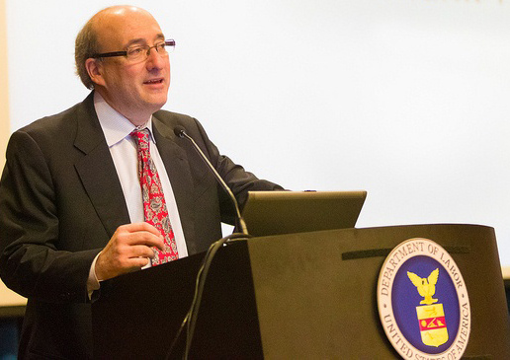
Assistant Secretary,
Dr. David Michaels

Slide 35
Occupational Safety And
Health Administration (DOL)
Has embraced “regulation by shaming” as an effective means of enforcement:
  Severe Violator Enforcement Program (“SVEP”)
  Derogatory press releases utilized
Assistant Secretary Michaels: “we will not hesitate to publicize the names of violators, especially when their actions place the safety and health of workers in danger.”

Slide 36
Retaliation: Proposed Rule
Under the proposed retaliation provisions, if an employer retaliates against an employee for reporting an injury or illness or otherwise discourages an employee from reporting an injury or illness, OSHA will not have to wait for the employee to file a whistleblower complaint alleging a violation of section 11(c).
Instead, OSHA may initiate a recordkeeping inspection and issue citations for violations of the new anti-retaliation provisions in the recordkeeping regulation.

Slide 37

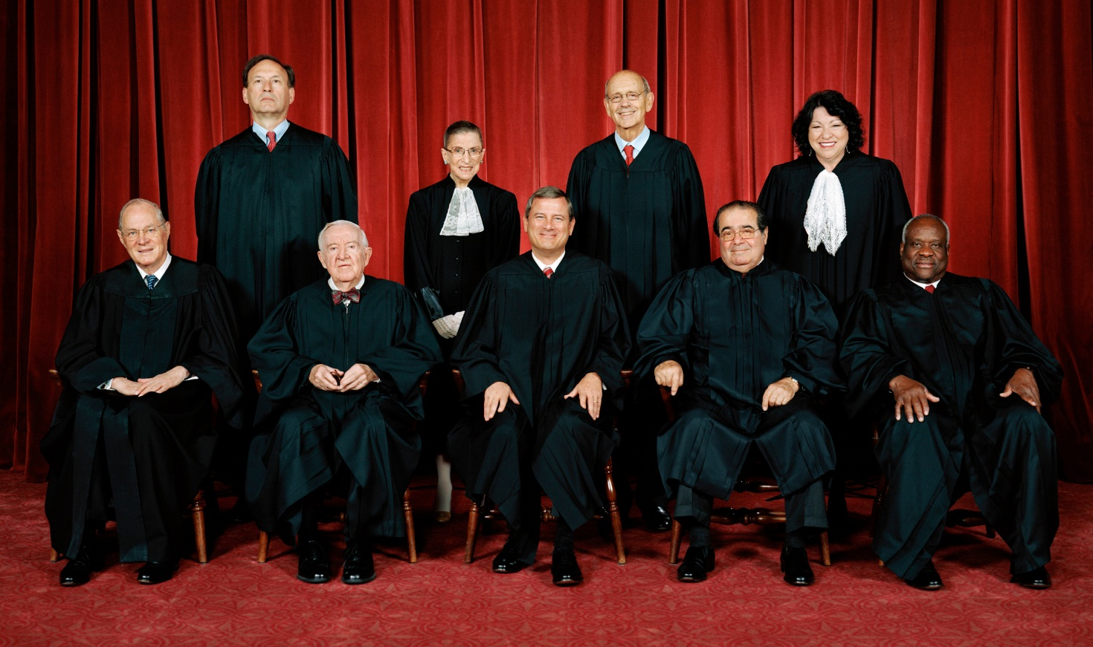

Slide 38
Young v. United Parcel Service
No. 12-1226
Decision Below: 707 F.3d 437
(4th Cir. 2013)
Petition Filed: April 8, 2013

Slide 39
Question Presented:
Whether the federal Pregnancy Discrimination Act, 42 U.S.C. § 2000e(k), requires an employer that provides work accommodations to nonpregnant employees with work limitations to provide work accommodations to pregnant employees who are “similar in their ability or inability to work.”

Slide 40
Young v. UPS
Facts
Young started working for UPS in 1999. Young held a position as a part-time, early morning driver.
During her pregnancy, Young provided her supervisor with a note from her doctor indicating that she should not lift more than twenty pounds for the first twenty weeks of her pregnancy and not more than ten pounds thereafter.

Slide 41
Young v. UPS
Under UPS policy and the Union’s Collective Bargaining Agreement, a pregnant employee can continue working as long as she can perform the essential functions of her job, but is ineligible for light duty work for any limitations arising solely as result of her pregnancy.

Slide 42
Perez v. Mortgage Bankers Association
No. 13-1041
(U.S.D.C. Dist. Of Columbia Circuit )
Petition Filed: February 28, 2014

Slide 43
Holding:
The D.C. Circuit’s Paralyzed Veterans doctrine, which requires agencies to use the notice-and-comment process before it can significantly revise an interpretive rule, is contrary to the clear text of the Administrative Procedure Act’s rulemaking provisions and improperly imposes on agencies an obligation beyond the Act’s maximum procedural requirements.
Judgment:
Reversed, 9-0, in an opinion by Justice Sotomayor on March 9, 2015. Justice Alito joined except for Part III–B, and filed an opinion concurring in part and concurring in the judgment. Justice Scalia and Justice Thomas filed opinions concurring in the judgment.

Slide 44
Perez v. Mortgage Bankers Ass’n
“I would therefore restore the balance originally struck by the APA with respect to an agency’s interpretation of its own regulations… The agency is free to interpret its own regulations with or without notice and comment; but courts will decide – with no deference to the agency – whether that interpretation is correct.”
- Justice Antonin Scalia

Slide 45
Florida
Supreme Court Review
Delva v. The Continental Group, Inc., No. SC12-231 (Fla. Apr. 14, 2014).
  Issue: Does the Florida Civil Rights Act’s ban on discrimination based on gender cover claims of pregnancy discrimination?
  Held: Yes.
    The FCRA does not include the word “pregnancy.”
    However, the statute prohibits employment discrimination against any individual because of the individual’s sex.
    The Court noted that “pregnancy is a natural condition unique to women and a primary characteristic of the female sex …”

Slide 46
?? Questions ??
Title Goes Here
William E. Grob
William.Grob@ogletreedeakins.com
(813) 221-7228

